Slide 1

Umeå is a progressive and growing municipality that strives to be a leader in northern Europe.
With a focus on sustainable development, innovation and equality, we continue to be an inclusive city and welcomes everyone who wants to live here.
Updated January 15 2025

Slide 2
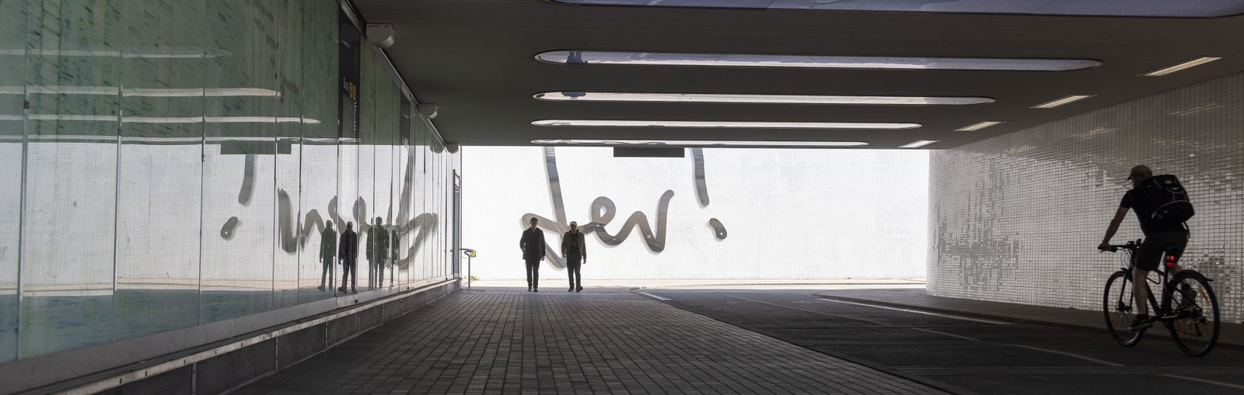
In Umeå equality and sustainability are fundamental blocks as we develop the city towards our vision.
In 2023 an ambitious climate roadmap was adopted, stating that the municipality should be climate neutral by 2040.

Slide 3
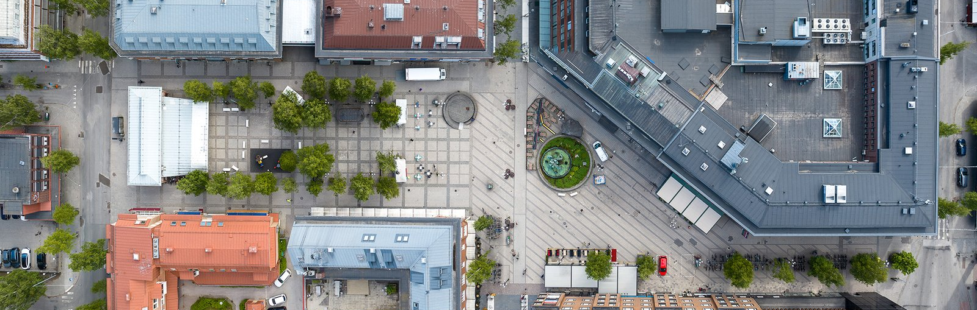
Umeå is growing fast – and has been since the 1970’s. Our vision is to have at least 200,000 inhabitants by 2050.
Today over 136,000 people from all corners of the world live in our municipality.

Slide 4
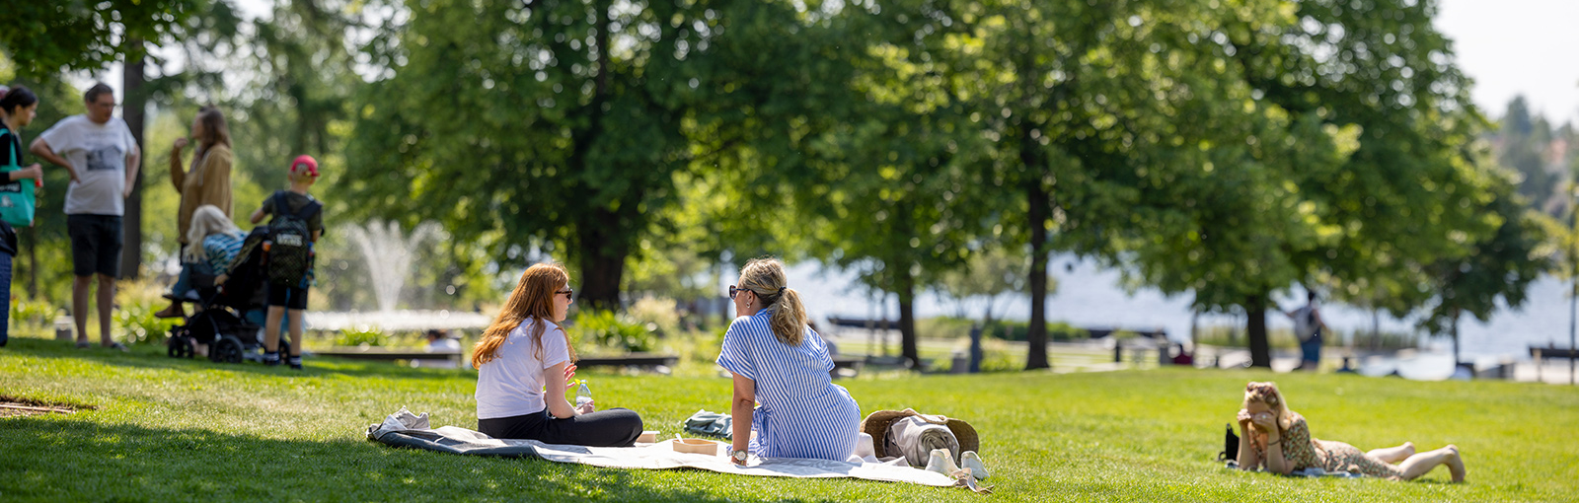
Umeå is Sweden's best municipality to live and reside in, according to an independent survey in 2024.
The survey is based on factors such as education, healthcare, jobs, infrastructure, and safety.

Slide 5
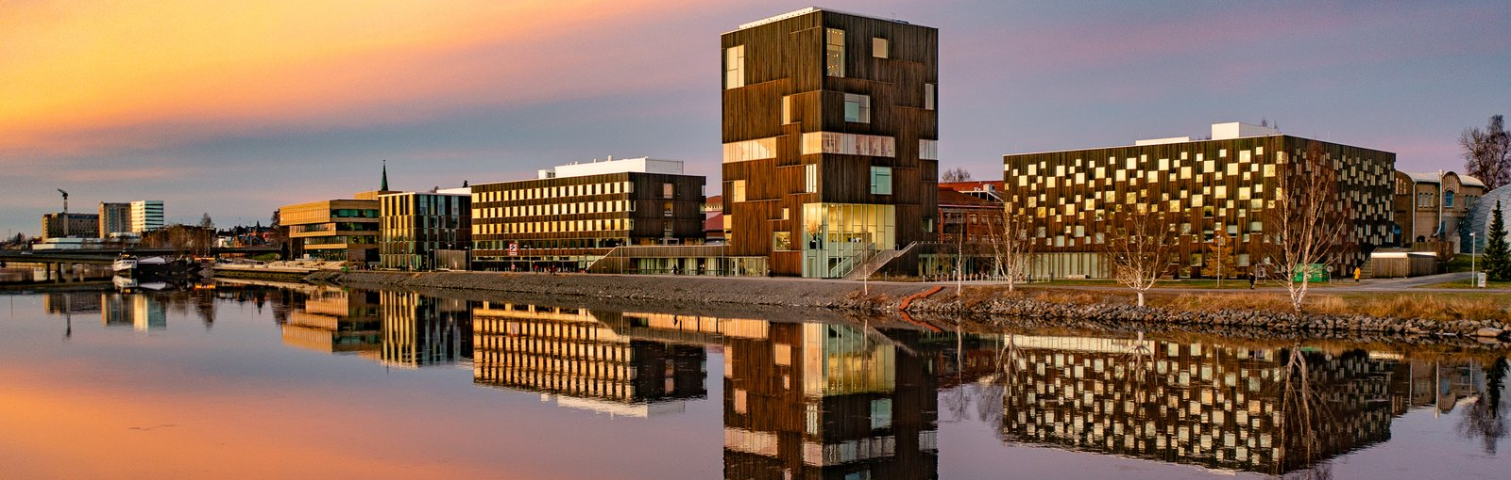
Umeå is northern Sweden's fastest sustainably growing region.
We attract young people, contributing to strong population growth.

Slide 6
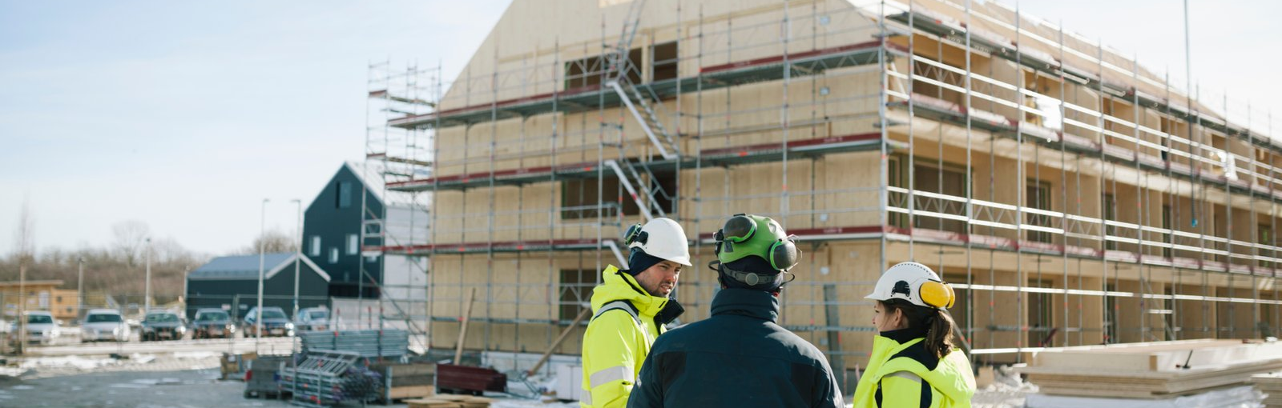
Umeå is one of Sweden's strongest growing real estate markets. We are leading in our part of the country.
Newsec ranks Umeå at 6th place when real estate markets in Sweden's largest municipalities are compared.

Slide 7

BYT BILD
Umeå is an equality role model. Our strategic work for equal rights continues to inspire others to follow.
In 2024 a global magazine called Umeå “the most feminist city in the world” – well we are probably one of them.

Slide 8
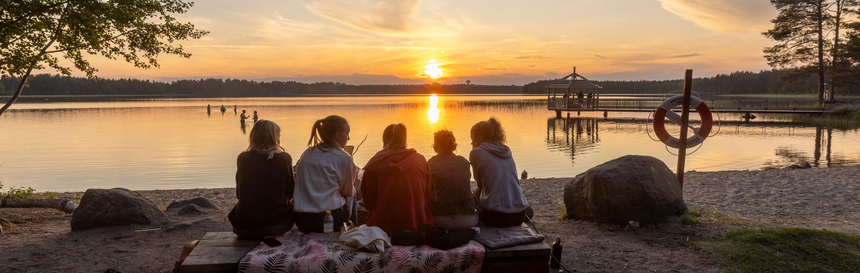
Umeå is both country and city. The central parts grow densely and at the same time, every third inhabitant lives outside the city.
Close to 90 percent of homes in Umeå are built where bicycle or bus are the easiest ways to get to work and study.

Slide 9
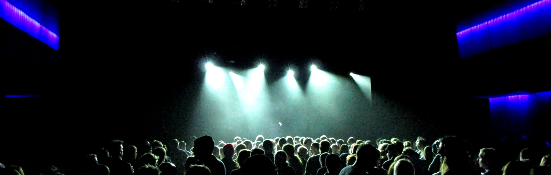
Umeå is a community and cultural municipality where engagement is as natural as the water that connects the city.
Every year, we allocate over 32 million SEK to our associations. This makes Umeå an active and safe municipality.

Slide 10
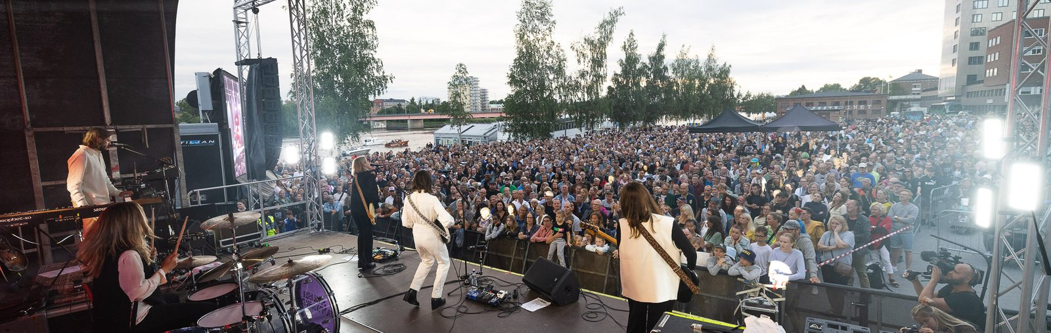
Bild
Umeå is a leading cultural city with a strong DIY-tradition. Culture has its natural place in Umeå.
We know that culture provides perspectives, opens doors and connects people across cultures and ages.

Slide 11
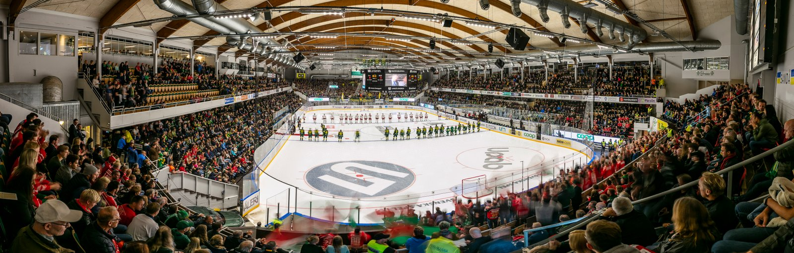
Umeå is one of Sweden's leading sport municipalities and consistently ranks high in national rankings.
Our 241 sports associations engage, build community, and contribute to Umeå's continued safe and secure growth.

Slide 12
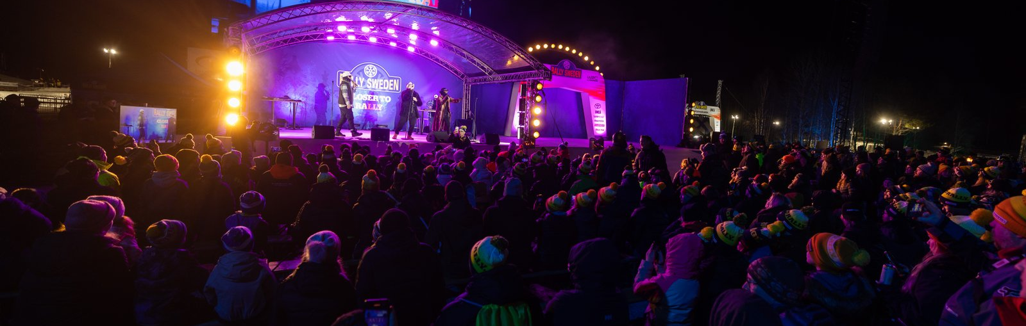
Umeå is northern Sweden's largest meeting and event city. Hundreds of meetings give new perspectives each year.
Rally World Championship, Jazz Festival, Littfest, Umeå Football Festival, Brännbollsyran, House of Metal and more!

Slide 13
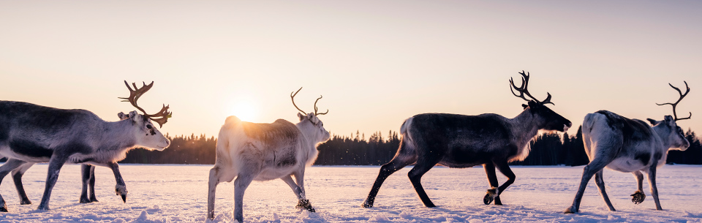
Ubmeje, Umeå in sami language, is a natural part of Sápmi. Ubmeje has been reindeer grazing land for several hundred years.
Umeå municipality is an administrative area for three minority languages; Finnish, Meänkieli, and Umesami.

Slide 14
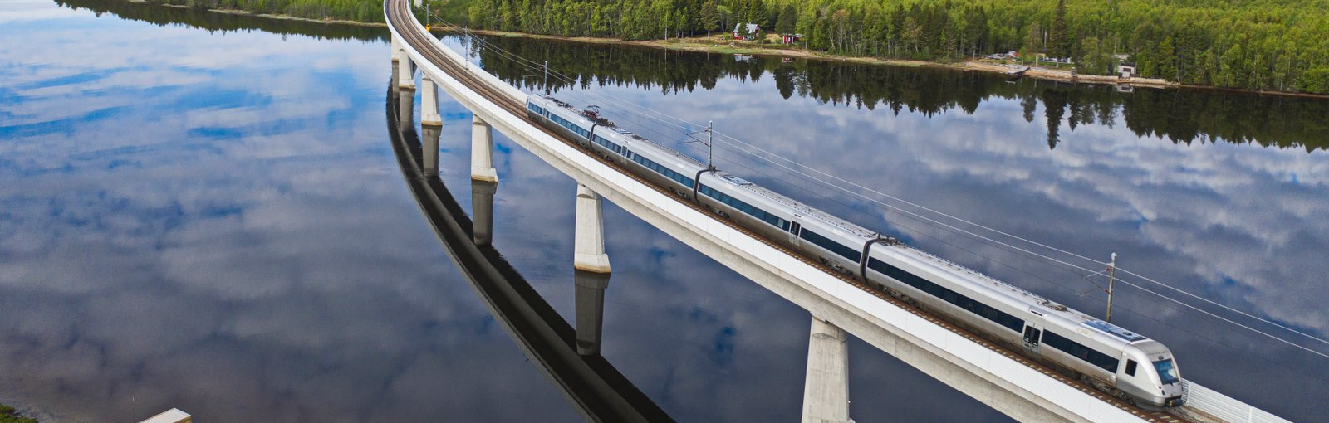
Our location makes Umeå a natural hub for infrastructure and logistics in all directions. One of the best in Sweden.
Umeå has a large airport, train connections, a ferry to Vaasa, and great road connections (E4/E12).

Slide 15
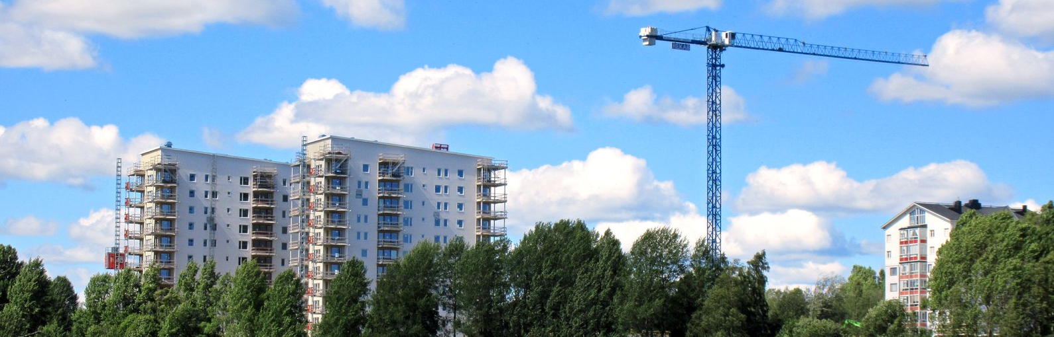
Umeå is growing. In five years, more job opportunities have been created through 8,800 new jobs and 800 new employers.
We continue to build for the future and make room for future neighbors. The goal is to complete 2,000 homes every year.

Slide 16
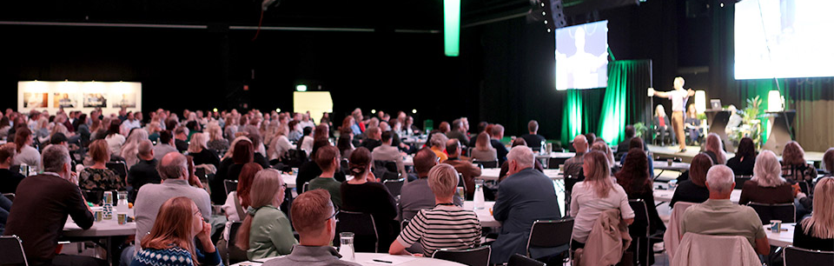
Umeå municipality is northern Sweden's largest employer and will recruit 1,000 new colleagues annually over the next decade.
Over 13,000 brave, sharp, safe, and proud employees make important contributions every day.

Slide 17
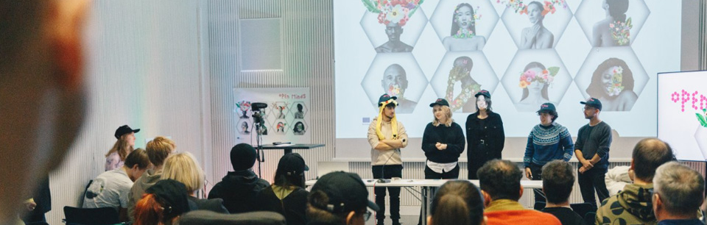
Leading universities strengthen Umeå and give new perspectives in various fields, including Nobel Prize-winning research.
39,000 students choose to study in Umeå. Many of them stay and contribute to our and their own development.

Slide 18
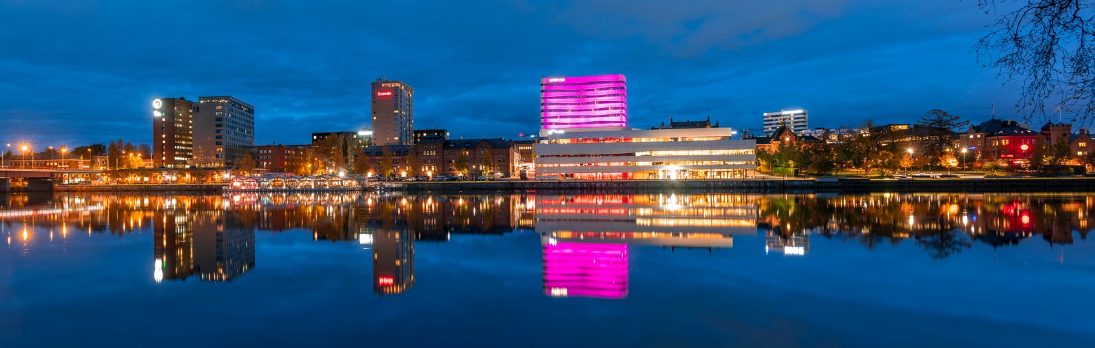
With a focus on sustainable development, innovation and inclusion Umeå continues to be an attractive and equal place for both residents and businesses.
Maybe also for you? Please visit umea.se, where you can read more and be guided further.

